Slide 1

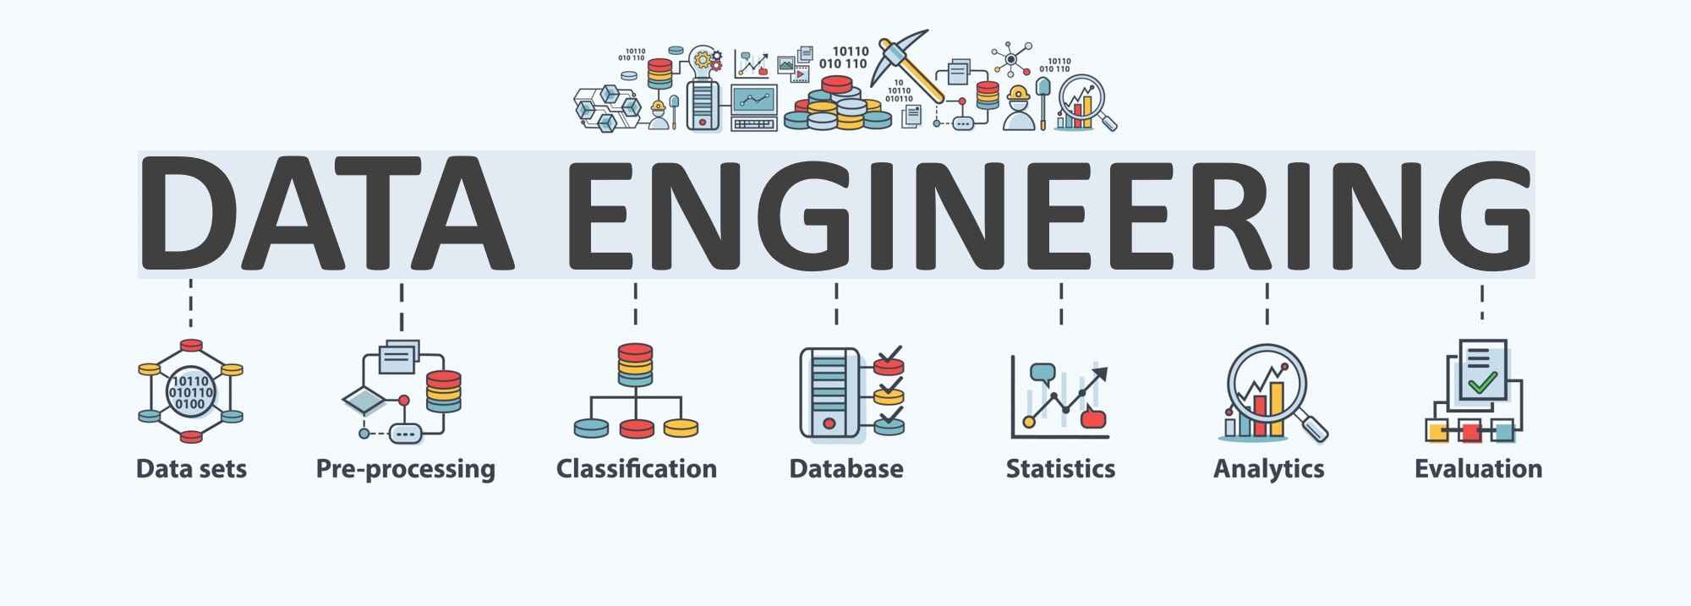
World Food Program
BY GROUP 3

Slide 2
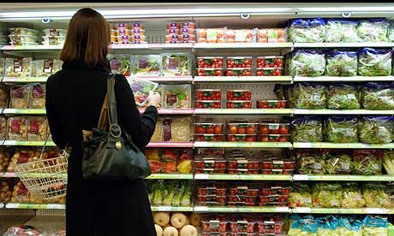
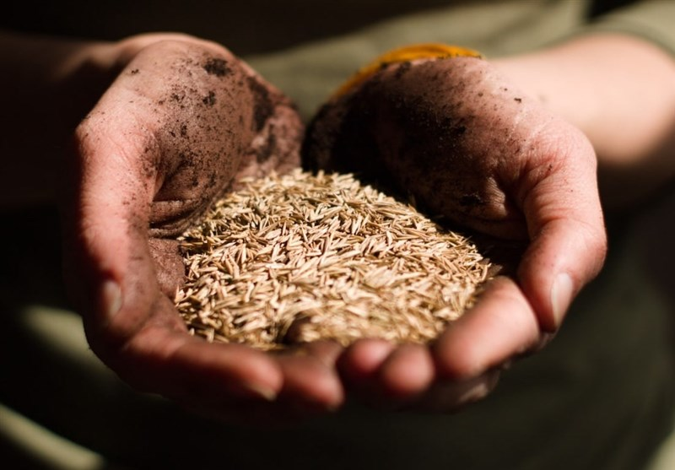
INTRODUCTION
In the current global landscape, fluctuations in food prices have become a significant area of concern. While domestic trends in the United States often receive the most attention, it is equally important to examine food pricing dynamics in other countries. This project seeks to support researchers in identifying notable shifts in global food prices and exploring potential correlations with international events that may contribute to these changes.

Slide 3







TECH STACK
01
01 - Data Analysis
Pandas, Numpy, Dask
02 - Database
02
SQLite, SQLAlchemy
03
03 - Exploratory Analysis Tool
04
04 - Programming Language
Jupyter Notebook, Dask Dataframe
Python
Notes:
© Copyright PresentationGO.com – The free PowerPoint and Google Slides template library

Slide 4
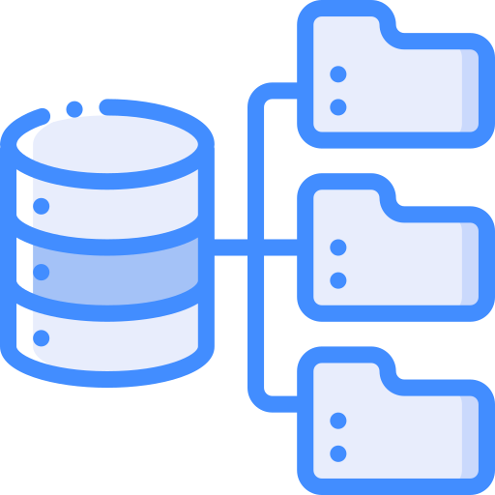

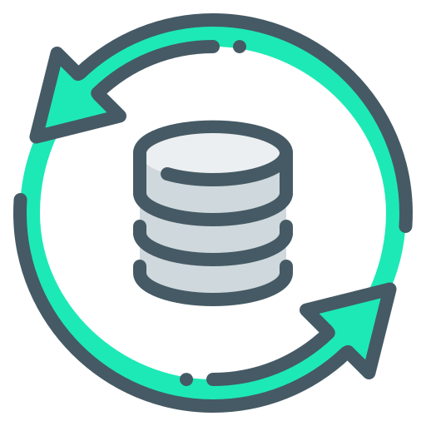
DATA PROCESS
EXTRACT
TRANSFORM
LOAD
Retrieves and verifies data from various sources
Processes and organizes extracted data into usable form
Moves transform data to a database

Slide 5
DATABASE EMPLOYED IN THIS STUDY
DATA COLLECTION
DATA INGESTION
DATA CLEANING & PROCESSING
DATA TRANSFORNMATION
STORAGE & MANAGMENT
DATA VALIDATION
Data Collection: Gathered datasets from international organizations: World Bank, FAO
Data Ingestion: Extracted data using an Api call and then imported it into Dask DataFrame.
Data Cleaning & Preprocessing: Standardized formats, renamed columns to conform with the database and normalized variables for uniformity.
Data Transformation: Aggregated, filtered, and reformatted data to prepare it for analysis and visualization.
Storage & Management: We created a SQLite file to serve as the main storage or database. We create sessions using SQL Alchemy to do queries and do CRUD operations
Data Validation: Verified accuracy and consistency to ensure data quality before analysis.
.

Slide 6
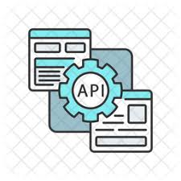
EXTRACT
01
In data science extraction refers to the act of obtaining the data from the various sources we may find it in.
02
In the case of our project, we gathered our data from the World Food Program by way of an API call.
03
This is always the first step of the ETL or any analysis process.

Slide 7
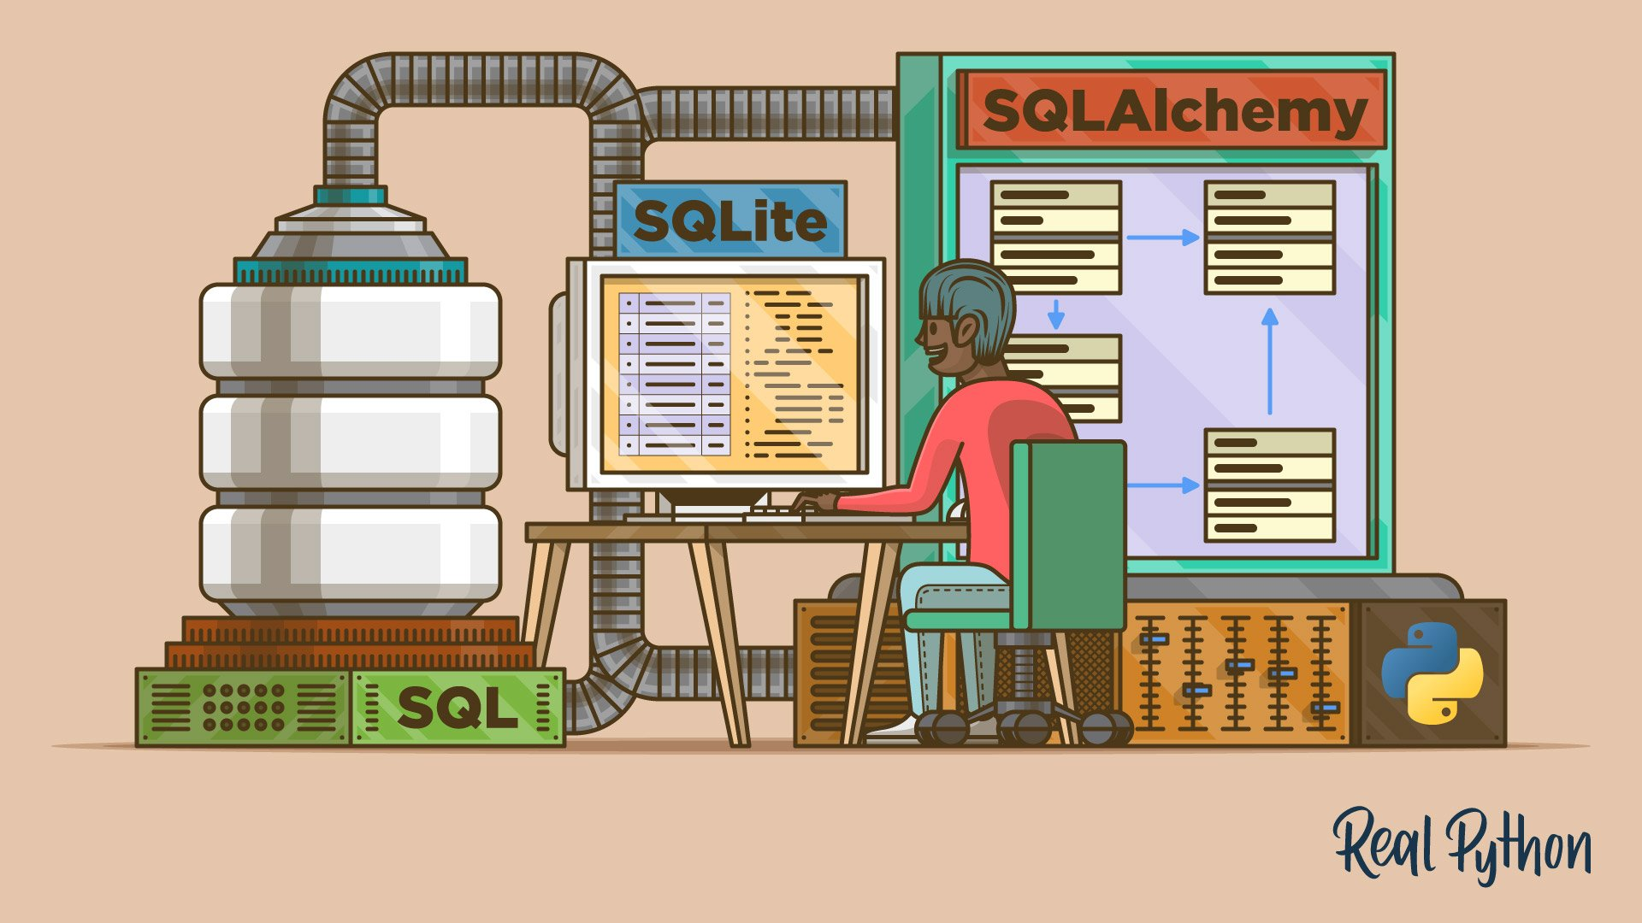
TRANSFORM
Transform: After extraction we have the data in its raw most basic form. Not all data is created equal and requires cleaning. This comes in the way of transforming it
We used Dask to do the heavy lifting of cleaning our large data set by dropping unnecessary columns using parallel processing.
We further cleaned and refined our data with SQLite by renaming and isolating key factors of our data.

Slide 8

LOAD
Load – Final Step of the ETL Process
The final stage of the ETL process involves storing the cleaned data in a suitable repository for further analysis. This step ensures data is securely stored and optimized for efficient querying. We selected SQLite as our data warehouse solution due to its flexibility and ability to handle larger datasets, making it ideal for our needs.

Slide 9

Dask:
What is it?
Dask is the python library that we used to transform our data. It allows for parallel computing and works efficiently by delaying computations until they are needed. This was key in our process as we had over 500,000 records and started with over 500 columns to iterate through!

Slide 10
Questions that our dataset can answer

Slide 11
1. Do we see noticeable inflation during 2007-2009?

Slide 12
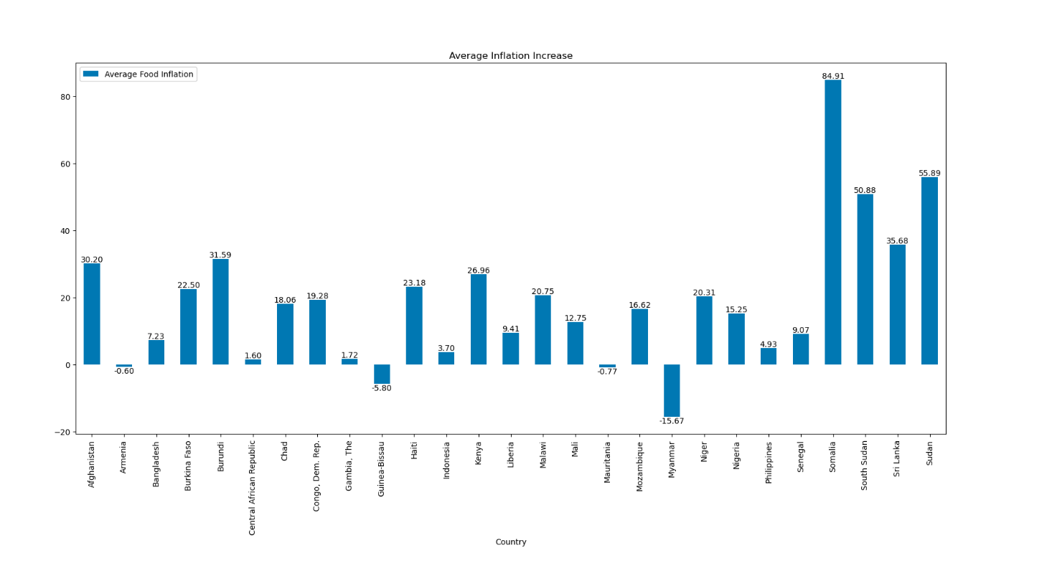
The Answer is Yes
A clear inflation trend is emerging across North Africa and the Middle East.
Countries like Sudan, Somalia, and Afghanistan show significant inflation rates.
Contributing Factors:
Social and political instability disrupting economic stability
Geographic challenges affecting agricultural productivity
Influence of global economic trends and external shocks

Slide 13
What went wrong?
As with any project there is a degree of certainty that something will not be smooth. We wanted to highlight a couple of ours for you.
Data Size:
We have a rather large data set. Pulling our data was the first issue. We had tried an array options from a multi-processing and multi-threading techniques, to the traditional PANDAS API Call.
File Size:
Even with our cleaned data, our CSV’s and Database documents were too large for GitHub, this in turn brought on more Git issues.

Slide 14
THANK YOU

